Slide 1

Type of hackers
What are the three main types of hackers?
Hackers fall into three general categories: black hat hackers, white hat hackers, and gray hat hackers. Although hackers are often associated with exploiting vulnerabilities to gain unauthorized access to computers, systems, or networks, not all hacking is malicious or illegal.
In its purest sense, hacking is simply the application of computer skills to solve a particular problem. There are many different types of hackers, and a lot of hacking activities are beneficial, because they uncover programming weaknesses that help developers improve software products.

Slide 2


Black Hat Hacker
Black hat hackers are cybercriminals that illegally crack systems with malicious intent. Seeking to gain unauthorized access to computer systems is the definition of black hat hacking. Once a black hat hacker finds a security vulnerability, they try to exploit it, often by implanting a virus or other type of malware such as a trojan.
Ransomware attacks are another favored ploy that black hat hackers use to extort financial gains or breach data systems.
Black hat hackers are also referred to as malicious hackers, unethical hackers, and crackers.

Slide 3


White Hat Hacker
White hat hackers, also known as ethical security hackers, identify and fix vulnerabilities. Hacking into systems with the permission of the organizations they hack into, white hat hackers try to uncover system weaknesses in order to fix them and help strengthen overall internet security.
Many cybersecurity leaders started out as white hat hackers, but the vital role played by ethical hacking is still widely misunderstood, as made clear by a recent ethical hacking case in Germany.
White hat hackers working on a team can be referred to as sneakers, hacker clubs, red teams, or tiger teams.

Slide 4


Grey Hat Hacker
Gray hat hackers may not have the criminal or malicious intent of a black hat hacker, but they also don’t have the prior knowledge or consent of those whose systems they hack into. Nevertheless, when gray hat hackers uncover weaknesses such as zero-day vulnerabilities, they report them rather than fully exploiting them. But gray hat hackers may demand payment in exchange for providing full details of what they uncovered.

Slide 5

What’s the difference between white, black, and gray hat hackers?
The main difference between white, black, and gray hat hackers is the motivation or intent that each type of hacker has when they break into computer systems.
White hat hackers probe cybersecurity weaknesses to help organizations develop stronger security;
black hat hackers are motivated by malicious intent; and
Gray hat hackers operate in the nebulous area in between — they’re not malicious, but they’re not always ethical either.

Slide 6

Other kinds of hackers
Hacker Type | Description | Threat Level
Hacktivist | Purpose-driven hackers using “ethical” hacking to support a political or social cause. | Medium
Script Kiddies | Novices who use pre-created scripts and programs for hacking. | Medium
Whistle Blowers | Employees or insiders who expose illegal or unethical activities within organizations. | Medium
Blue Hat Hackers | Experts employed by companies to test and improve their cybersecurity. | Low
State Sponsored Hackers | Government-employed hackers targeting individuals and organizations of adversaries. | High
Cyber Terrorist | Digital terrorists who disrupt infrastructure and spread fear or propaganda to advance an ideology. | High
Green Hat Hackers | Inexperienced hackers who lack technical skills but can still cause harm. | Medium
Elite Hackers | Highly skilled professionals who innovate and create new cybersecurity threats. | High

Slide 7

Organizational Data
TRADITIONAL DATA
Traditional data is typically generated and maintained by all organizations, big and small. It includes the following:
Transactional data such as details relating to buying and selling, production activities and basic organizational operations such as any information used to make employment decisions.
Intellectual property such as patents, trademarks and new product plans, which allows an organization to gain economic advantage over its competitors. This information is often considered a trade secret and losing it could prove disastrous for the future of a company.
Financial data such as income statements, balance sheets and cash flow statements, which provide insight into the health of a company.

Slide 8
INTERNET OF THINGS (IOT) AND BIG DATA
IoT is a large network of physical objects, such as sensors, software and other equipment.
All of these ‘things’ are connected to the Internet, with the ability to collect and share data. And given that storage options are expanding through the cloud and virtualization, it’s no surprise that the emergence of IoT has led to an exponential growth in data, creating a new area of interest in technology and business called 'Big Data.'

Slide 9
The Cube
The McCumber Cube is a model framework created by John McCumber in 1991 to help organizations establish and evaluate information security initiatives by considering all of the related factors that impact them. This security model has three dimensions:
The foundational principles for protecting information systems.
The protection of information in each of its possible states.
The security measures used to protect data.

Slide 10
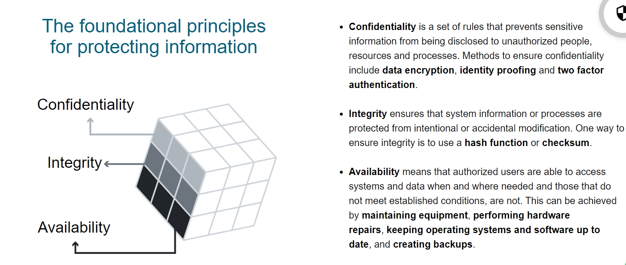

Slide 11
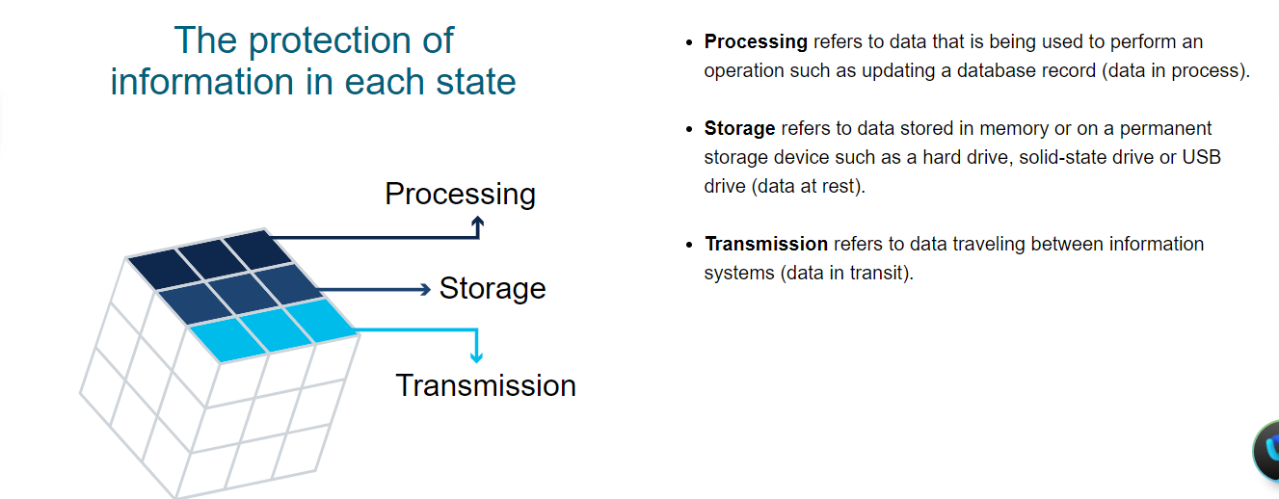

Slide 12
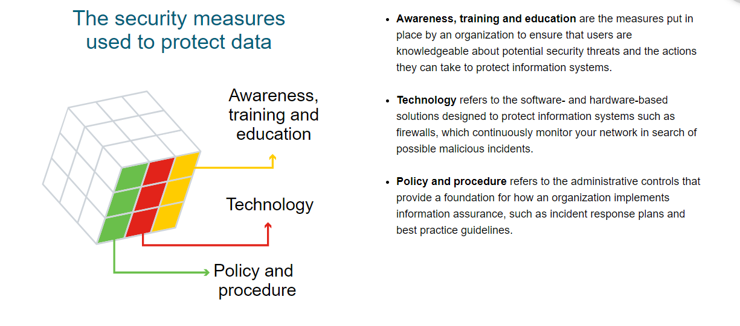

Slide 13
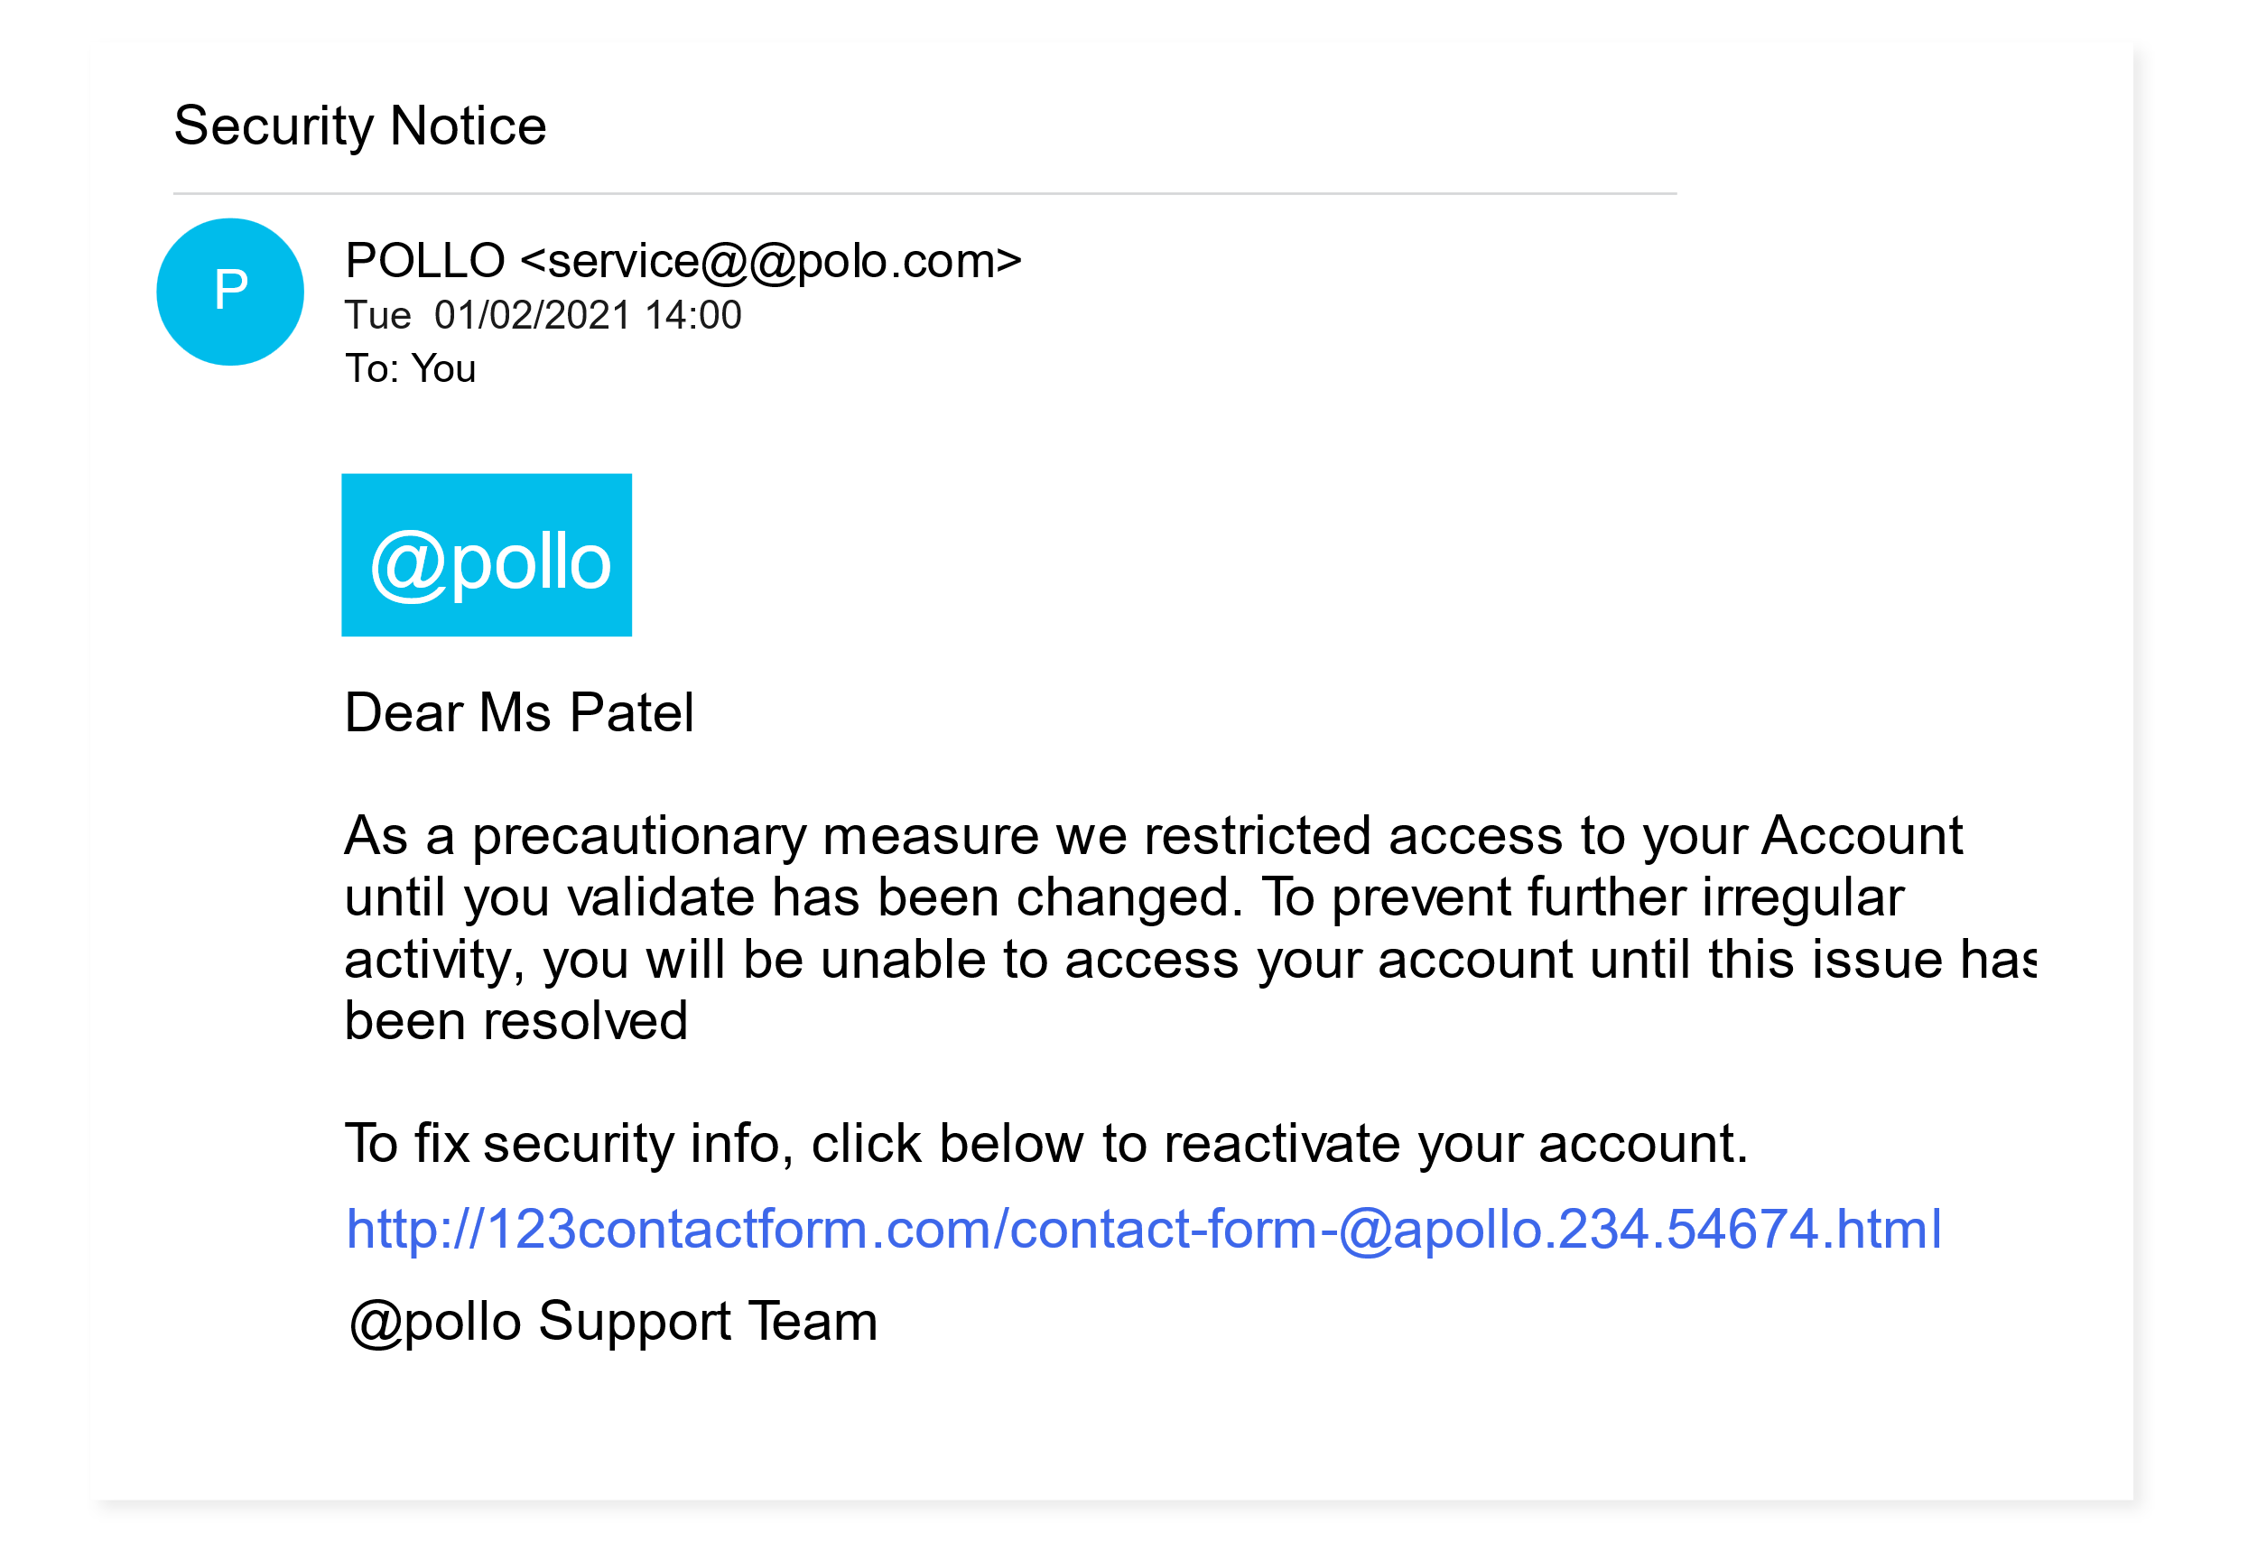
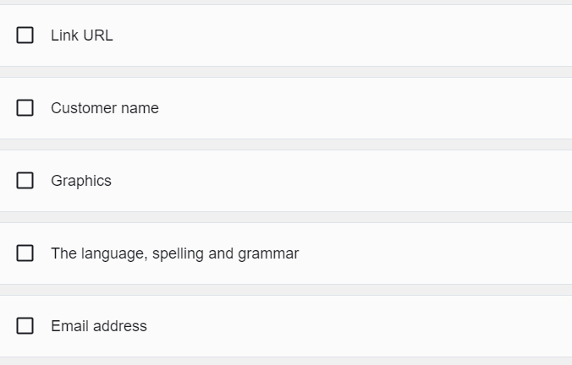
What Do You Think?
A concerned customer has forwarded on what they believe to be a fraudulent email. It looks as if it has been sent by @Apollo but something appears a little 'phish-y.'

Slide 14
Consequences of a Security Breach
> Reputational Damage :
A security breach can have a negative long-term impact on an organization’s reputation that has taken years to build. Customers, particularly those who have been adversely affected by the breach, will need to be notified and may seek compensation and/or turn to a reliable and secure competitor. Employees may also choose to leave in light of a scandal.
Depending on the severity of a breach, it can take a long time to repair an organization’s reputation.
Vandalism:
A hacker or hacking group may vandalize an organization’s website by posting untrue information. They might even just make a few minor edits to your organization’s phone number or address, which can be trickier to detect.
In either case, online vandalism can portray unprofessionalism and have a negative impact on your organization’s reputation and credibility.
Theft
A data breach often involves an incident where sensitive personal data has been stolen. Cybercriminals can make this information public or exploit it to steal an individual’s money and/or identity.

Slide 15

Cont….. Consequences of a Security Breach
Loss Of Revenue
The financial impact of a security breach can be devastating. For example, hackers can take down an organization’s website, preventing it from doing business online. A loss of customer information may impede company growth and expansion. It may demand further investment in an organization’s security infrastructure. And let’s not forget that organizations may face large fines or penalties if they do not protect online data.
Damaged Intellectual Property
A security breach could also have a devastating impact on the competitiveness of an organization, particularly if hackers are able to get their hands on confidential documents, trade secrets and intellectual property.
Despite the best of intentions and all the safeguards you can put in place, protecting organizations from every cyberattack is not feasible.
Cybercriminals are constantly finding new ways to attack and, eventually, they will succeed.
When they do, it will be up to cybersecurity professionals, like you, to respond quickly to minimize its impact.

Slide 16
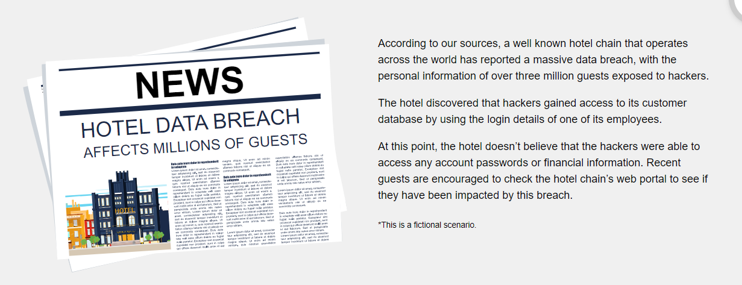
QUIZ

Slide 17
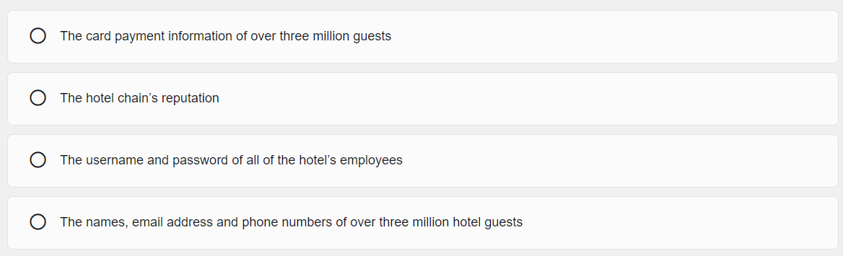

Slide 18
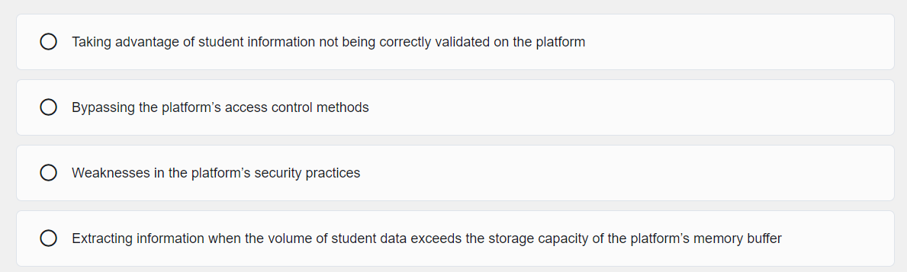
What is Exploit ?
What exploits did the hackers use in this case to gain access to valuable personal information?
2. A popular online training platform admitted leaving the personal data of millions of its students (many of them minors) exposed on a publicly accessible cloud database.
Hackers were able to directly access students’ full names, email addresses, phone numbers, and school enrollment details from the Internet!
Thinking back to each of the two security breach examples outlined above, what measures could these organizations have implemented in order to have prevented these security breaches?

Slide 19
Thank you for your time 😊

Slide 20
Next Lesson 😊 > Cyber Attackers > Cyber Warfare

